Slide 1

ACCIDENT SEVERITY PREDICTION IN USA
IBM CAPSTONE PROJECT
By,
Nandan Rajeev

Slide 2
Introduction
With the continuously growing number of automobiles on the road, the road safety issues have been on the rise. Globally, approximately 1.35 million people die in road crashes each year and on average 3,700 people lose their lives every day on the roads. In the USA alone, more than 38,000 people die every year in crashes on roadways. The U.S. traffic fatality rate is 12.4 deaths per 100,000 inhabitants. Road crashes are the leading cause of death in the U.S. for people aged 1-54.
We will explore the options to help reduce the accident risks on the road with the power of data.
The primary aim of this project is to train machine learning models to accurately predict the severity of an accident.
We will also be exploring the dataset to get valuable insights which help us better understand the road traffic problems which can help take suitable action.

Slide 3
DATA
The data used in this project is a dataset consisting of road traffic accidents that occurred in USA between February 2016 and June 2020, covering all the states. The dataset consists of around 3.5 million entries. This data has been collected by Lyft, for analyzing the delays caused by accidents.
Our target variable here, will be the severity rating. Higher the severity of an accident, greater the traffic delay as the roads are often partially closed while the medical and road services are at work. By relating the traffic delay to the severity of the accident, the accidents are assigned a severity rating from 1 to 4 with 4 being the most severe.

Slide 4
DATA VISUALIZATION

Slide 5
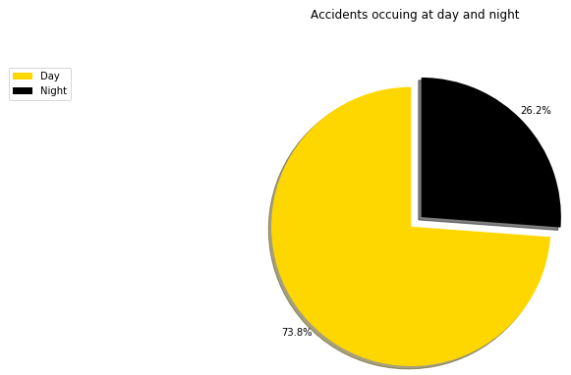
Accidents occurring at day/night

Slide 6
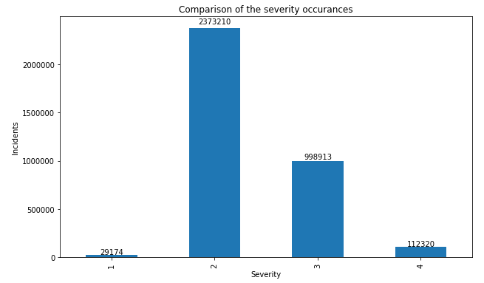
COMPARISON OF SEVERITY OCCURANCES

Slide 7
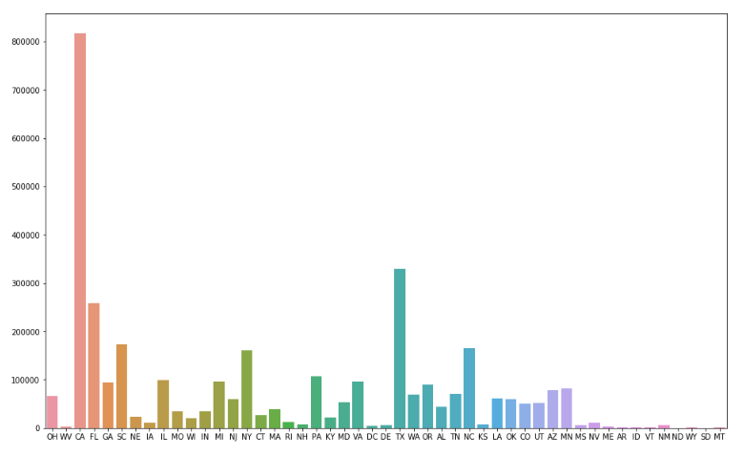
STATE-WISE ACCIDENTS REPORT

Slide 8
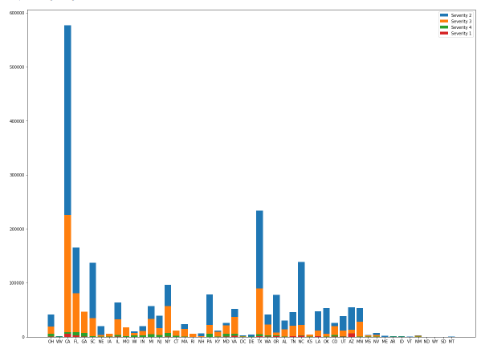
STATE-WISE ACCIDENTS REPORT WITH SEVERITY

Slide 9
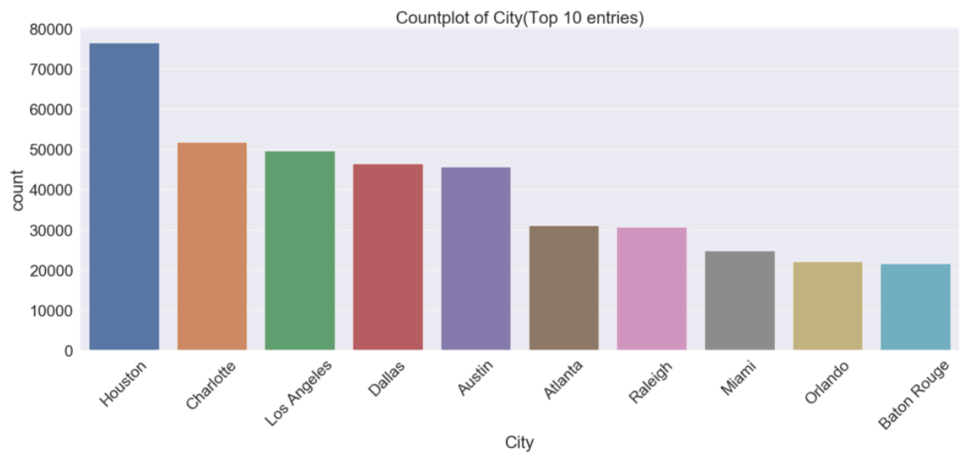
CITY-WISE ACCIDENTS report

Slide 10
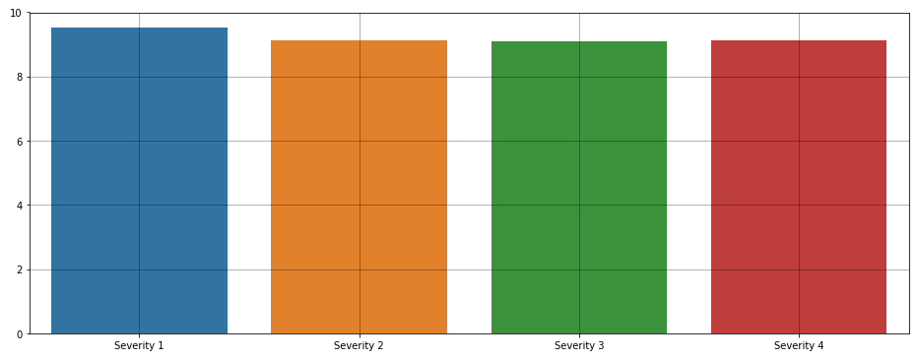
EFFECT OF VISIBILITY ON SEVERITY

Slide 11
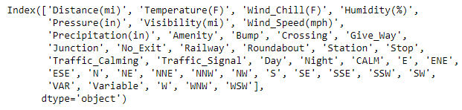
FINAL DATA SET
After cleaning and transforming the dataset, the following 41 parameters were considered for the modelling stage -
286,816 entries were taken into the training set for building the model.
122,922 entries were taken into the testing set for model evaluation.

Slide 12
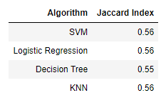
PREDICTION MODELS
The prediction models were all trained and tested to predict the severity rating. Their accuracies have been tabulated below -
The accuracy tends to 97% if we consider the prediction to be correct if it predicts the immediate neighboring severity level. This tells us that we can improve the overall efficiency by increasing the testing set size so the model can more accurately differentiate between the neighboring severity levels.

Slide 13
ACCURACY IMPROVEMENT
Consider the full dataset. We can fix a very large part of the missing data by interpolating the weather conditions. For this to be accurate, we need to sort the dataset by geo-location and time of occurrence. This will help create the weather parameters by considering the conditions of the areas in its vicinity at a time close to the incident.
Support Vector Machine - We can increase the maximum iterations to get a more improved solution. By default, we consider 1000 iterations. Increasing this will increase the computational time as well.
K Nearest Neighbours Method - The optimal value of K has not been found here. To find the most suitable k value, we will need to run a FOR loop for a large range (like 10,400). This requires extremely high computational resources but will result with a better accuracy.
Improving the data collection quality. There are many areas where the data recording process can be improved. If a more accurate and precise dataset was available (for eg- the numerous similar weather conditions which were phrased differently) the prediction capabilities will also be better.

Slide 14
CONCLUSION
We have gained some valuable insights on the accidents that occur in USA. We got a better understanding of some factors and how they influence the outcome of such incidents. Some additional information such as knowing the amount and frequency of accidents that occur state-wise and city-wise also suggests that certain places need better regulation of road traffic.
The machine learning models have been trained to predict and the most suitable algorithms have been identified. Now, we can select the ML algorithm and train it on the full available dataset taking into consideration the previous mentioned factors to get a better predicting accuracy.

Slide 15
THANK YOU

